Slide 1

AI-Driven Diffusion and LoRA Models for customizable 3D Room Visualization and Design Enhancement

Slide 2
PURPOSE OF THE PROJECT
This project focuses on developing an AI-powered 3D room visualization tool that allows users to design and customize rooms effortlessly. It combines Diffusion Models for generating realistic 3D layouts and LoRA (Low-Rank Adaptation) Models for fine-tuning designs based on user feedback. The system is designed to simplify 3D interior design, making it accessible to both professionals and non-experts by supporting multimodal input (text descriptions, sketches, and mood boards). It provides real-time, high-quality rendering while enabling iterative customizations.

Slide 3
Literature review
S.No | Reference | Focus Area | Key Contribution
1 | Patel, A., & Mandekar, M. (2024). Immersive Interior Design: Exploring Enhanced Visualization Through Augmented Reality Technologies. EasyChair. | Immersive interior design visualization using AR technologies. | Demonstrates how AR enhances the design process with real-time interaction and visualization.
2 | Dunston, P. S., Arns, L. L., McGlothlin, J. D., Lasker, G. C., & Kushner, A. G. (2011). An immersive virtual reality mock-up for design review of hospital patient rooms. Collaborative Design in Virtual Environments, 167-176. | Virtual reality in collaborative design reviews. | Highlights the use of VR mock-ups to improve collaboration, reduce errors, and enhance design reviews.
3 | Gu, N., Kim, M. J., & Maher, M. L. (2011). Technological advancements in synchronous collaboration: The effect of 3D virtual worlds and tangible user interfaces on architectural design. Automation in Construction, 20(3), 270-278. | Real-time collaboration in architectural design using 3D virtual environments. | Explores how 3D virtual worlds and tangible user interfaces improve design communication and iteration.
4 | Zhao, Y., Szpiro, S., Shi, L., & Azenkot, S. (2019). Designing and evaluating a customizable head-mounted vision enhancement system for people with low vision. ACM Transactions on Accessible Computing (TACCESS), 12(4), 1-46. | Customizable vision enhancement systems. | Proposes a customizable head-mounted system, showcasing its adaptability to enhance visual perception.
5 | Badia i Andreu, J. (2024). Customizable and performant 3D portfolio. | Customizable 3D modeling and visualization. | Emphasizes techniques for creating high-performance and customizable 3D models.

Slide 4
Literature review
S.No | Reference | Focus Area | Key Contribution
6 | Kim, S. J., Cao, D. D., Spinola, F., Lee, S. J., & Cho, K. S. (2024). RoomRecon: High-Quality Textured Room Layout Reconstruction on Mobile Devices. IEEE International Symposium on Mixed and Augmented Reality (ISMAR), pp. 544-553. | Mobile-based 3D room layout reconstruction. | Develops a mobile system for high-quality, textured 3D room layouts with real-time functionality.
7 | Yan, W., Culp, C., & Graf, R. (2011). Integrating BIM and gaming for real-time interactive architectural visualization. Automation in Construction, 20(4), 446-458. | Integration of BIM and interactive gaming. | Demonstrates how BIM and gaming technologies improve interactive architectural visualizations.
8 | Natephra, W., Motamedi, A., Fukuda, T., & Yabuki, N. (2017). Integrating building information modeling and virtual reality development engines for building indoor lighting design. Visualization in Engineering, 5, 1-21. | BIM integration with virtual reality for lighting design. | Shows improved accuracy in indoor lighting design through BIM and VR integration.
9 | Mahrous, A., & Schneider, G. B. (2019). Enhancing student learning of removable prosthodontics using the latest advancements in virtual 3D modeling. Journal of Prosthodontics, 28(4), 471-472. | Virtual 3D modeling in education. | Demonstrates the use of virtual 3D modeling to enhance student learning in prosthodontics.
10 | Fusco, G., & Zhu, J. (2023). Enhancing hurricane risk perception and mitigation behavior through customized virtual reality. Advanced Engineering Informatics, 58, 102212. | Customized VR environments for risk perception. | Highlights how VR can improve risk awareness and mitigation behavior.

Slide 5
Research Gap
Despite advancements in immersive technologies and AI-powered 3D modeling, significant challenges remain in providing an intuitive, customizable, and multimodal design solution. Existing tools often have the following limitations:
Limited Customization Capabilities: Many AI-based design tools can generate static models but lack robust options for real-time, iterative customization based on user feedback. Users are restricted to predefined templates or layouts.
Single-Modal Input: Most systems support only one type of input (e.g., text or sketches), limiting the flexibility to accommodate diverse user needs. There is a lack of integration between text descriptions, sketches, and visual references like mood boards.
Absence of Real-Time Processing: Tools often require lengthy processing times for generating or modifying designs, making real-time interaction difficult. Systems capable of near-instantaneous feedback and updates are underexplored.
Underutilization of Diffusion and LoRA Models: While diffusion models have demonstrated high-quality image generation, their application in generating complex 3D room layouts is still limited. Similarly, LoRA models have not been extensively applied to enable efficient, user-driven customizations in architectural design.

Slide 6
Research Gap
5. Limited Adoption of LoRA for Efficient Fine-Tuning: Although LoRA models provide lightweight, parameter-efficient tuning, their potential for real-time design modifications and interactive rendering in 3D space has not been fully implemented.
6. Scalability and Deployment Challenges: AI-driven interior design solutions often require high computational resources, making cloud-based, mobile-friendly, or edge AI solutions for scalable and accessible design applications a major gap.
7. Lack of Explainability and Interpretability in AI-Generated Designs: Many deep learning-based design tools do not provide visual reasoning behind AI decisions, limiting user trust and usability.
This project addresses these research gaps by developing a system that integrates both diffusion and LoRA models to provide multimodal input support, iterative refinement, and real-time customization, thereby enhancing user accessibility and creative control in 3D room visualization.

Slide 7
Objectives
The main objectives of this research are to address the identified gaps in existing 3D room visualization and customization tools. The specific objectives are as follows:
Develop an AI-driven 3D visualization tool: Create a system that integrates diffusion and LoRA models to generate and customize 3D room designs.
Enable multimodal input support: Allow users to provide inputs through various formats, including textual descriptions, sketches, and mood boards, to enhance design flexibility and creativity.
Provide real-time customization and refinement: Implement iterative design refinement, enabling users to update room layouts, textures, and furniture arrangements based on feedback with minimal delays.
Ensure high-quality photorealistic outputs: Generate visually realistic 3D room models that meet user expectations in terms of detail and aesthetics.
Enhance accessibility for non-professionals: Design an intuitive user interface that simplifies 3D room modeling, making the tool accessible to users without technical expertise.
Evaluate system performance: Conduct user studies to assess the system's effectiveness, usability, and performance compared to traditional and existing AI-based 3D modeling tools

Slide 8
Hardware and Software Specifications
Hardware Specifications
Processor: Multi-core
RAM: 16 GB.
Storage: 512 TB SSD for fast read/write access.
GPU: NVIDIA RTX 3060 or higher.
Display: High-resolution monitor (4K recommended).
Peripherals: Mouse, keyboard, optional graphics tablet.
Software Specifications
Operating System: Windows 10, macOS, or Linux.
Languages: Python (AI development), JavaScript (front-end).
Development Environment: PyCharm, Visual Studio Code.
Libraries: PyTorch, TensorFlow, OpenCV, Three.js.
Database: PostgreSQL or MongoDB.
Cloud Services: AWS, Google Cloud, or Azure.

Slide 9
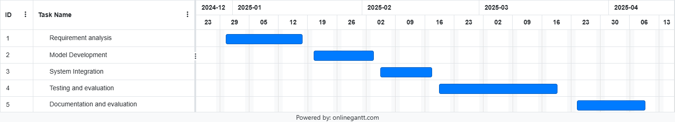
Gantt Chart with Work Breakdown structure

Slide 10
Requirement Analysis
Functional Requirements
Multimodal Input: Support text, sketches, and mood boards for 3D visualization.
3D Room Generation: Use diffusion models to generate initial layouts.
Customization: Enable iterative updates via LoRA models.
Real-Time Visualization: Provide instant feedback and updates to models.
Output Export: Support high-resolution export (PNG, JPEG, FBX).
Non-Functional Requirements
Performance: Generate models within 10 seconds, real-time updates in 5 seconds.
Scalability: Handle multiple users and large-scale projects efficiently.
Accuracy: Produce high-quality, photorealistic designs.
Security: Encrypt data and ensure secure communication.
Maintainability: Use modular architecture for easy updates and feature integration

Slide 11
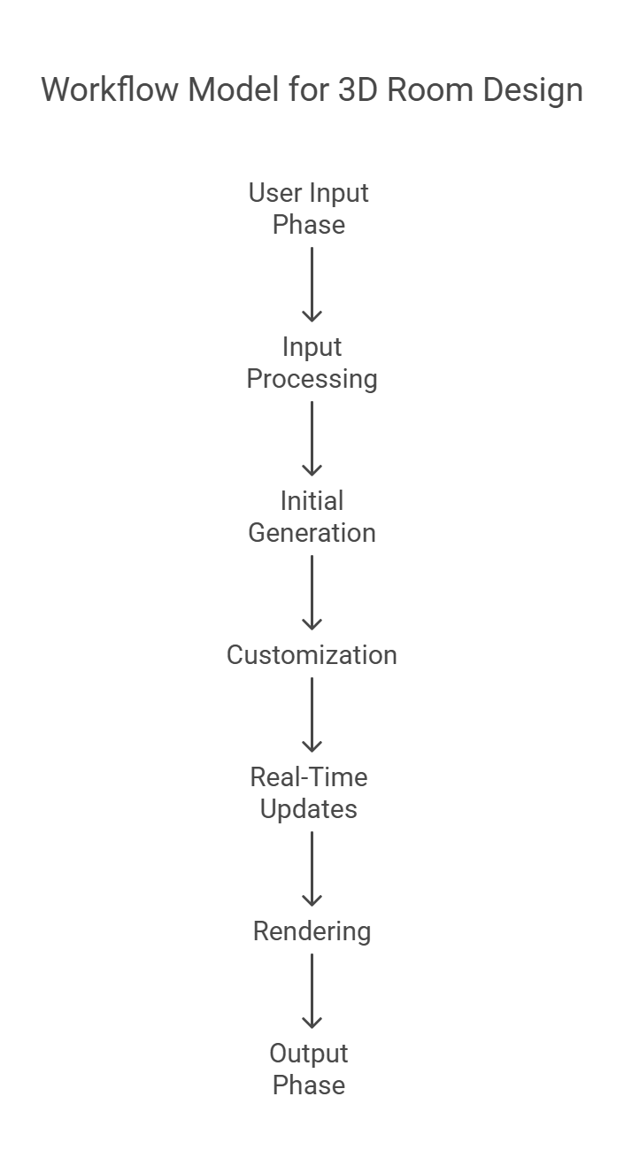
Workflow Model

Slide 12
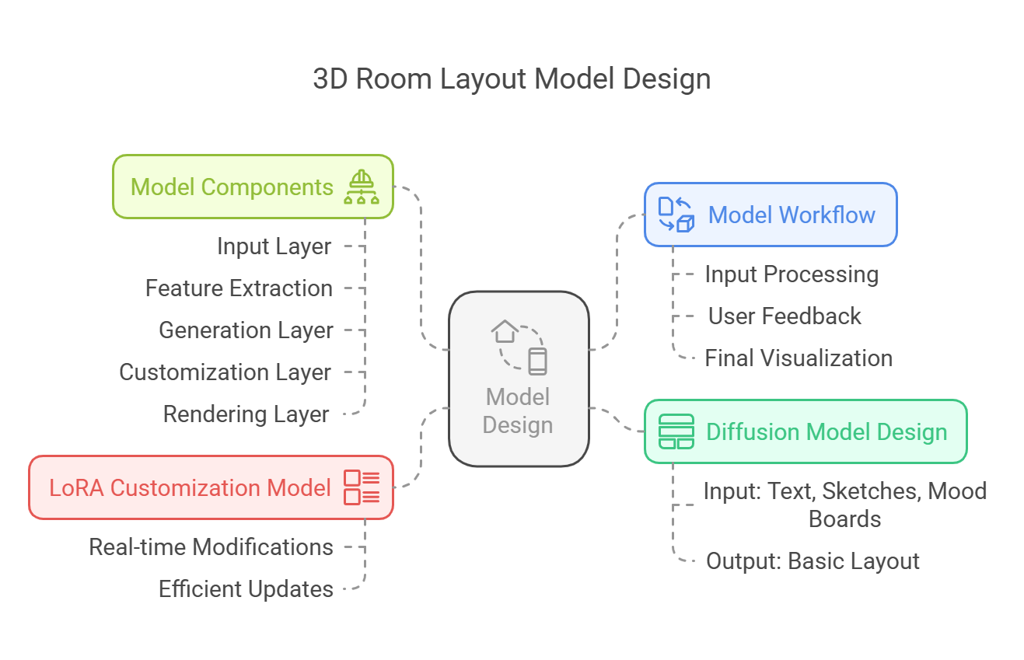
Model Design

Slide 13
References
Patel, A., & Mandekar, M. (2024). Immersive Interior Design: Exploring Enhanced Visualization Through Augmented Reality Technologies (No. 12786). EasyChair.
Dunston, P. S., Arns, L. L., McGlothlin, J. D., Lasker, G. C., & Kushner, A. G. (2011). An immersive virtual reality mock-up for design review of hospital patient rooms. Collaborative Design in Virtual Environments, 167-176.
Gu, N., Kim, M. J., & Maher, M. L. (2011). Technological advancements in synchronous collaboration: The effect of 3D virtual worlds and tangible user interfaces on architectural design. Automation in Construction, 20(3), 270-278.
Zhao, Y., Szpiro, S., Shi, L., & Azenkot, S. (2019). Designing and evaluating a customizable head-mounted vision enhancement system for people with low vision. ACM Transactions on Accessible Computing (TACCESS), 12(4), 1-46.
Badia i Andreu, J. (2024). Customizable and performant 3D portfolio.
Kim, S. J., Cao, D. D., Spinola, F., Lee, S. J., & Cho, K. S. (2024, October). RoomRecon: High-Quality Textured Room Layout Reconstruction on Mobile Devices. In 2024 IEEE International Symposium on Mixed and Augmented Reality (ISMAR) (pp. 544-553). IEEE.
Yan, W., Culp, C., & Graf, R. (2011). Integrating BIM and gaming for real-time interactive architectural visualization. Automation in Construction, 20(4), 446-458.
Natephra, W., Motamedi, A., Fukuda, T., & Yabuki, N. (2017). Integrating building information modeling and virtual reality development engines for building indoor lighting design. Visualization in Engineering, 5, 1-21.
Mahrous, A., & Schneider, G. B. (2019). Enhancing student learning of removable prosthodontics using the latest advancements in virtual 3D modeling. Journal of Prosthodontics, 28(4), 471-472.
Fusco, G., & Zhu, J. (2023). Enhancing hurricane risk perception and mitigation behavior through customized virtual reality. Advanced Engineering Informatics, 58, 102212.

